Slide 1


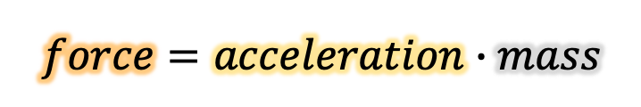


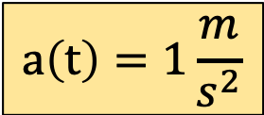
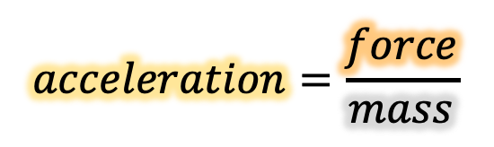









acceleration
$$M\left(t\right)=1kg$$
mass
force
$$1$$
$$0$$
$$t \left[s\right]$$
$$0$$
$$1$$
$$2$$
$$3$$
$$4$$
$$F\left(t\right)=1N$$
$$force=acceleration∙mass$$
$$1$$
$$0$$
$$t \left[s\right]$$
$$acceleration=\frac{force}{mass}$$
$$0$$
$$1$$
$$2$$
$$3$$
$$4$$
$$a\left(t\right)=1\frac{m}{s^{2}}$$
$$1$$
$$0$$
$$t \left[s\right]$$
$$0$$
$$1$$
$$2$$
$$3$$
$$4$$

Slide 2
acceleration
$$M\left(t\right)=1kg$$
mass
force
$$1$$
$$0$$
$$t \left[s\right]$$
$$0$$
$$1$$
$$2$$
$$3$$
$$4$$
$$F\left(t\right)=1N$$
$$force=acceleration∙mass$$
$$1$$
$$0$$
$$t \left[s\right]$$
$$acceleration=\frac{force}{mass}$$
$$0$$
$$1$$
$$2$$
$$3$$
$$4$$
$$a\left(t\right)=1\frac{m}{s^{2}}$$
$$1$$
$$0$$
What are the units of area?
$$t \left[s\right]$$
$$0$$
$$1$$
$$2$$
$$3$$
$$4$$

Slide 3



acceleration
How do you find units of area?
The units of one dimension multiplied by the units of the other dimension.
$$M\left(t\right)=1kg$$
mass
force
$$1$$
$$0$$
$$t \left[s\right]$$
$$0$$
$$1$$
$$2$$
$$3$$
$$4$$
$$F\left(t\right)=1N$$
$$force=acceleration∙mass$$
$$1$$
$$10 cm$$
$${100 cm}^{2}$$
$$0$$
$$t \left[s\right]$$
$$acceleration=\frac{force}{mass}$$
$$0$$
$$1$$
$$2$$
$$3$$
$$4$$
$$a\left(t\right)=1\frac{m}{s^{2}}$$
$$1$$
$$0$$
What are the units of area?
$$10 cm$$
$$t \left[s\right]$$
$$0$$
$$1$$
$$2$$
$$3$$
$$4$$

Slide 4



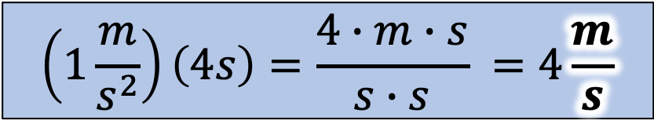


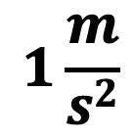



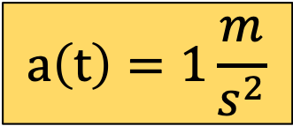
$$a\left(t\right)=1\frac{m}{s^{2}}$$
$$1$$
$$1\frac{m}{s^{2}}$$
$$0$$
What are the units of area?
$$0$$
$$1$$
$$2$$
$$3$$
$$4$$
$$4s$$
$$\left(1\frac{m}{s^{2}}\right)\left(4s\right)=\frac{4∙m∙s}{s∙s} =4\frac{m}{s}$$
Area:
…is a velocity!
After 4 seconds, we gained 4 m/s velocity.

Slide 5




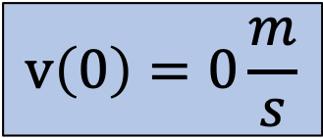



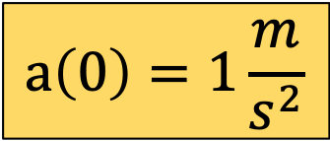

$$1$$
$$a\left(0\right)=1\frac{m}{s^{2}}$$
$$0$$
$$time$$
$$0$$
$$1$$
$$2$$
$$3$$
$$4$$
Let’s graph velocity(time)…
$$1$$
$$v\left(0\right)=0\frac{m}{s}$$
$$0$$
$$time$$
$$0$$
$$1$$
$$2$$
$$3$$
$$4$$

Slide 6
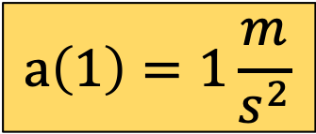
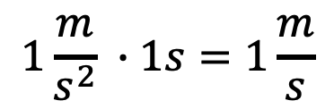
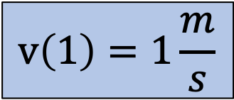
$$1$$
$$a\left(1\right)=1\frac{m}{s^{2}}$$
$$0$$
$$time$$
$$0$$
$$1$$
$$2$$
$$3$$
$$4$$
$$1\frac{m}{s^{2}} ∙1s=1\frac{m}{s}$$
$$1$$
$$v\left(1\right)=1\frac{m}{s}$$
$$0$$
$$time$$
$$0$$
$$1$$
$$2$$
$$3$$
$$4$$

Slide 7
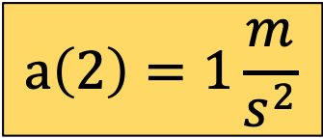
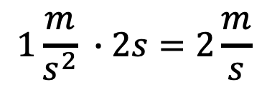
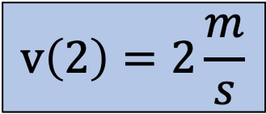
$$1$$
$$a\left(2\right)=1\frac{m}{s^{2}}$$
$$0$$
$$time$$
$$0$$
$$1$$
$$2$$
$$3$$
$$4$$
$$1\frac{m}{s^{2}} ∙2s=2\frac{m}{s}$$
$$1$$
$$v\left(2\right)=2\frac{m}{s}$$
$$0$$
$$time$$
$$0$$
$$1$$
$$2$$
$$3$$
$$4$$

Slide 8
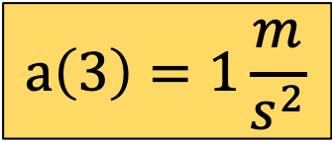
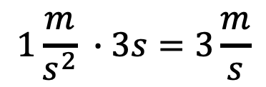
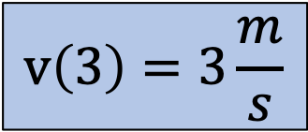
$$1$$
$$a\left(3\right)=1\frac{m}{s^{2}}$$
$$0$$
$$time$$
$$0$$
$$1$$
$$2$$
$$3$$
$$4$$
$$1\frac{m}{s^{2}} ∙3s=3\frac{m}{s}$$
$$1$$
$$v\left(3\right)=3\frac{m}{s}$$
$$0$$
$$time$$
$$0$$
$$1$$
$$2$$
$$3$$
$$4$$

Slide 9

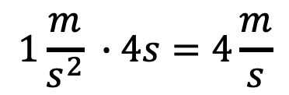
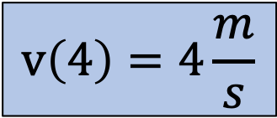
$$1$$
$$a\left(4\right)=1\frac{m}{s^{2}}$$
$$0$$
$$time$$
$$0$$
$$1$$
$$2$$
$$3$$
$$4$$
$$1\frac{m}{s^{2}} ∙4s=4\frac{m}{s}$$
What are the units of area?
$$1$$
$$v\left(4\right)=4\frac{m}{s}$$
$$0$$
$$time$$
$$0$$
$$1$$
$$2$$
$$3$$
$$4$$

Slide 10

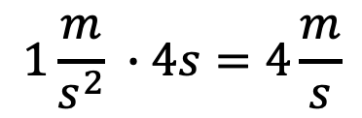


Remind me how to find the area of a triangle?
$$1$$
$$a\left(4\right)=1\frac{m}{s^{2}}$$
$${Area}_{ triangle}=\frac{1}{2}∙length∙width$$
$$0$$
$$time$$
$$0$$
$$1$$
$$2$$
$$3$$
$$4$$
$$1\frac{m}{s^{2}} ∙4s=4\frac{m}{s}$$
$$10 cm$$
$${50 cm}^{2}$$
What are the units of area?
$$1$$
$$v\left(4\right)=4\frac{m}{s}$$
$$0$$
$$time$$
$$0$$
$$1$$
$$10 cm$$
$$2$$
$$3$$
$$4$$

Slide 11
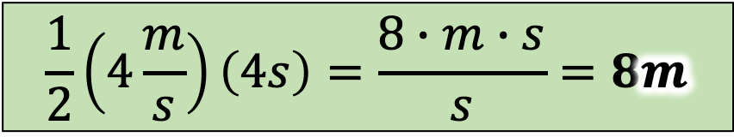


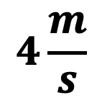




$$4\frac{m}{s}$$
What are the units of area?
$$1$$
$$0$$
$$time$$
$$0$$
$$1$$
$$2$$
$$3$$
$$4$$
$$4s$$
$$\frac{1}{2}\left(4\frac{m}{s}\right)\left(4s\right)=\frac{8∙m∙s}{s}=8m$$
In 4 seconds, we traveled 8m.
Area:
…is distance!

Slide 12























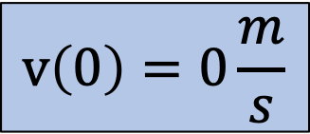
$$4$$
$$3$$
$$2$$
$$v\left(0\right)=0\frac{m}{s}$$
$$1$$
$$0$$
$$time$$
$$0$$
$$1$$
$$2$$
$$3$$
$$4$$
Let’s graph distance(time)…
$$8$$
$$7$$
$$6$$
$$5$$
$$4$$
$$3$$
$$2$$
$$s\left(0\right)=0m$$
$$1$$
$$0$$
$$0$$
$$1$$
$$2$$
$$3$$
$$4$$
$$time$$

Slide 13

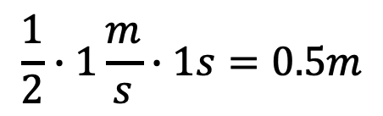
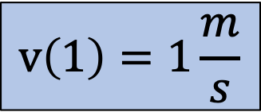
$$4$$
$$3$$
$$2$$
$$v\left(1\right)=1\frac{m}{s}$$
$$1$$
$$0$$
$$time$$
$$0$$
$$1$$
$$2$$
$$3$$
$$4$$
$$8$$
$$7$$
$$6$$
$$\frac{1}{2}∙1\frac{m}{s}∙1s=0.5m$$
$$5$$
$$4$$
$$3$$
$$2$$
$$s\left(1\right)=0.5m$$
$$1$$
$$0$$
$$0$$
$$1$$
$$2$$
$$3$$
$$4$$
$$time$$

Slide 14

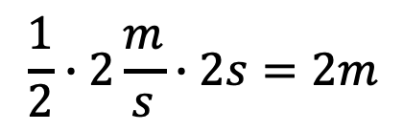
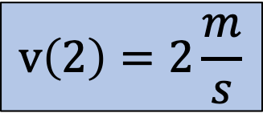
$$4$$
$$3$$
$$2$$
$$v\left(2\right)=2\frac{m}{s}$$
$$1$$
$$0$$
$$time$$
$$0$$
$$1$$
$$2$$
$$3$$
$$4$$
$$8$$
$$7$$
$$6$$
$$\frac{1}{2}∙2\frac{m}{s}∙2s=2m$$
$$5$$
$$4$$
$$3$$
$$2$$
$$s\left(2\right)=2m$$
$$1$$
$$0$$
$$0$$
$$1$$
$$2$$
$$3$$
$$4$$
$$time$$

Slide 15

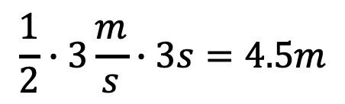
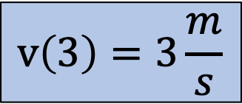
$$4$$
$$3$$
$$2$$
$$v\left(3\right)=3\frac{m}{s}$$
$$1$$
$$0$$
$$time$$
$$0$$
$$1$$
$$2$$
$$3$$
$$4$$
$$8$$
$$7$$
$$6$$
$$\frac{1}{2}∙3\frac{m}{s}∙3s=4.5m$$
$$5$$
$$4$$
$$3$$
$$2$$
$$s\left(3\right)=4.5m$$
$$1$$
$$0$$
$$0$$
$$1$$
$$2$$
$$3$$
$$4$$
$$time$$

Slide 16

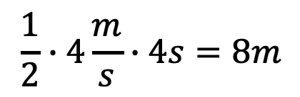
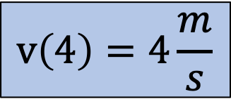
$$4$$
$$3$$
$$2$$
$$v\left(4\right)=4\frac{m}{s}$$
$$1$$
$$0$$
$$time$$
$$0$$
$$1$$
$$2$$
$$3$$
$$4$$
$$8$$
$$7$$
$$6$$
$$\frac{1}{2}∙4\frac{m}{s}∙4s=8m$$
$$5$$
$$4$$
$$3$$
$$2$$
$$s\left(4\right)=8m$$
$$1$$
$$0$$
$$0$$
$$1$$
$$2$$
$$3$$
$$4$$
$$time$$

Slide 17





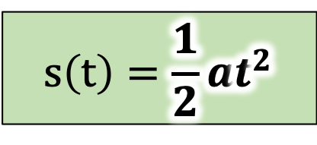





$$a$$
$$a\left(t\right)=a$$
Constant acceleration.
$$0$$
$$0$$
$$t$$
$$v$$
$$v\left(t\right)=at$$
Area created by the acceleration function.
$$0$$
$$0$$
$$t$$
$$s$$
$$s\left(t\right)=\frac{1}{2}at^{2}$$
Area created by the velocity function.
$$0$$
$$t$$

Slide 18
velocity
acceleration
mass
force
What happens if acceleration occurs while already moving at a velocity?

Slide 19







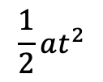

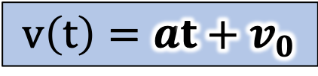


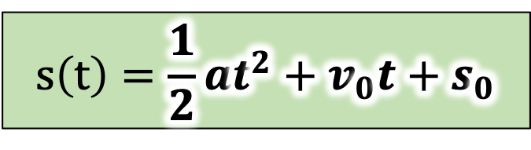





$$a$$
$$a\left(t\right)=a$$
Acceleration function is still a constant…
$$0$$
$$t$$
$$v$$
$$at$$
$$v\left(t\right)=at+v_{0}$$
$$v_{0}$$
But now we have an initial velocity constant…
$$v_{0}$$
$$0$$
$$t$$
$$s$$
$$s\left(t\right)=\frac{1}{2}at^{2}+v_{0}t+s_{0}$$
$$\frac{1}{2}at^{2}$$
$$v_{0}t$$
$$s_{0}$$
So we need to add the area created by the initial velocity, plus the initial distance constant.
$$s_{0}$$
$$0$$
$$t$$

Slide 20























What happens if there is a pause in the acceleration?
$$1$$
$$M\left(t\right)$$
$$0$$
$$t \left[s\right]$$
$$−1$$
$$0$$
$$1$$
$$2$$
$$3$$
$$4$$
$$1$$
$$F\left(t\right)$$
$$0$$
$$t \left[s\right]$$
$$−1$$
$$0$$
$$1$$
$$2$$
$$3$$
$$4$$
$$1$$
$$a\left(t\right)$$
$$0$$
$$t \left[s\right]$$
$$−1$$
$$0$$
$$1$$
$$2$$
$$3$$
$$4$$

Slide 21
$$1$$
$$a\left(0\right)=1\frac{m}{s^{2}}$$
$$0$$
$$time$$
$$0$$
$$1$$
$$2$$
$$3$$
$$4$$
Let’s graph velocity(time)…
$$1$$
$$v\left(0\right)=0\frac{m}{s}$$
$$0$$
$$time$$
$$0$$
$$1$$
$$2$$
$$3$$
$$4$$

Slide 22
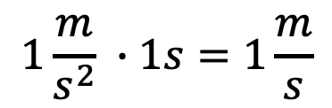
$$1$$
$$a\left(1\right)=1\frac{m}{s^{2}}$$
$$0$$
$$time$$
$$0$$
$$1$$
$$2$$
$$3$$
$$4$$
$$1\frac{m}{s^{2}} ∙1s=1\frac{m}{s}$$
$$1$$
$$v\left(1\right)=1\frac{m}{s}$$
$$0$$
$$time$$
$$0$$
$$1$$
$$2$$
$$3$$
$$4$$

Slide 23
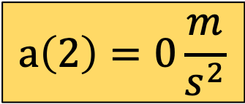
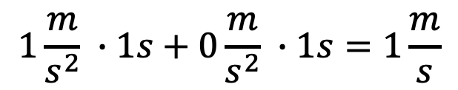
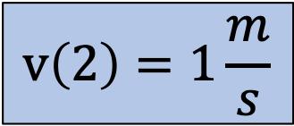
$$1$$
$$a\left(2\right)=0\frac{m}{s^{2}}$$
$$0$$
$$time$$
$$0$$
$$1$$
$$2$$
$$3$$
$$4$$
$$1\frac{m}{s^{2}} ∙1s+0\frac{m}{s^{2}} ∙1s=1\frac{m}{s}$$
$$1$$
$$v\left(2\right)=1\frac{m}{s}$$
$$0$$
$$time$$
$$0$$
$$1$$
$$2$$
$$3$$
$$4$$

Slide 24
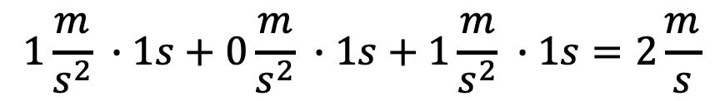
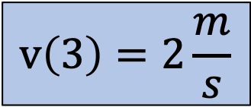
$$1$$
$$a\left(3\right)=1\frac{m}{s^{2}}$$
$$0$$
$$time$$
$$0$$
$$1$$
$$2$$
$$3$$
$$4$$
$$1\frac{m}{s^{2}} ∙1s+0\frac{m}{s^{2}} ∙1s+1\frac{m}{s^{2}} ∙1s=2\frac{m}{s}$$
$$1$$
$$v\left(3\right)=2\frac{m}{s}$$
$$0$$
$$time$$
$$0$$
$$1$$
$$2$$
$$3$$
$$4$$

Slide 25
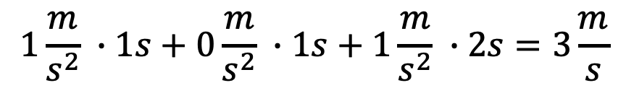
$$1$$
$$a\left(3\right)=1\frac{m}{s^{2}}$$
$$0$$
$$time$$
$$0$$
$$1$$
$$2$$
$$3$$
$$4$$
$$1\frac{m}{s^{2}} ∙1s+0\frac{m}{s^{2}} ∙1s+1\frac{m}{s^{2}} ∙2s=3\frac{m}{s}$$
$$1$$
$$v\left(3\right)=2\frac{m}{s}$$
$$0$$
$$time$$
$$0$$
$$1$$
$$2$$
$$3$$
$$4$$

Slide 26
$$4$$
$$3$$
$$2$$
$$v\left(0\right)=0\frac{m}{s}$$
$$1$$
$$0$$
$$time$$
$$0$$
$$1$$
$$2$$
$$3$$
$$4$$
Let’s graph distance(time)…
$$8$$
$$7$$
$$6$$
$$5$$
$$4$$
$$3$$
$$2$$
$$s\left(0\right)=0m$$
$$1$$
$$0$$
$$0$$
$$1$$
$$2$$
$$3$$
$$4$$
$$time$$

Slide 27
$$4$$
$$3$$
$$2$$
$$v\left(1\right)=1\frac{m}{s}$$
$$1$$
$$0$$
$$time$$
$$0$$
$$1$$
$$2$$
$$3$$
$$4$$
$$8$$
$$7$$
$$6$$
$$5$$
$$4$$
$$3$$
$$2$$
$$s\left(1\right)=0.5m$$
$$1$$
$$0$$
$$0$$
$$1$$
$$2$$
$$3$$
$$4$$
$$time$$

Slide 28

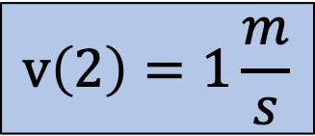
$$4$$
$$3$$
$$2$$
$$v\left(2\right)=1\frac{m}{s}$$
$$1$$
$$0$$
$$time$$
$$0$$
$$1$$
$$2$$
$$3$$
$$4$$
$$8$$
$$7$$
$$6$$
$$5$$
$$4$$
$$3$$
$$2$$
$$s\left(2\right)=1.5m$$
$$1$$
$$0$$
$$0$$
$$1$$
$$2$$
$$3$$
$$4$$
$$time$$

Slide 29

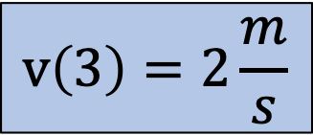
$$4$$
$$3$$
$$2$$
$$v\left(3\right)=2\frac{m}{s}$$
$$1$$
$$0$$
$$time$$
$$0$$
$$1$$
$$2$$
$$3$$
$$4$$
$$8$$
$$7$$
$$6$$
$$5$$
$$4$$
$$3$$
$$2$$
$$s\left(3\right)=3m$$
$$1$$
$$0$$
$$0$$
$$1$$
$$2$$
$$3$$
$$4$$
$$time$$

Slide 30

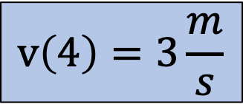
$$4$$
$$3$$
$$2$$
$$v\left(4\right)=3\frac{m}{s}$$
$$1$$
$$0$$
$$time$$
$$0$$
$$1$$
$$2$$
$$3$$
$$4$$
$$8$$
$$7$$
Previous distance graph
$$6$$
$$5$$
$$4$$
$$3$$
$$2$$
$$s\left(4\right)=5.5m$$
$$1$$
$$0$$
$$0$$
$$1$$
$$2$$
$$3$$
$$4$$
$$time$$

Slide 31


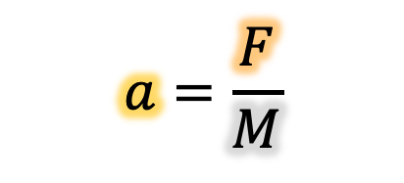
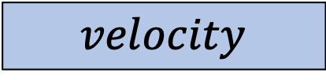
If we know our acceleration, then we can determine velocity and distance using area.
$$a=\frac{F}{M}$$
$$acceleration$$
area
???
$$velocity$$
area
???
$$distance$$
What if we know distance or velocity only?

Slide 32


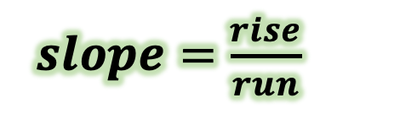














$$distance [m]$$
$$8$$
$$7$$
$$6$$
$$5$$
$$4$$
$$3$$
$$2$$
$$1$$
$$0$$
What are the units of slope?
$$0$$
$$1$$
$$2$$
$$3$$
$$4$$
$$time [s]$$
$slope=\frac{rise}{run}$

Slide 33
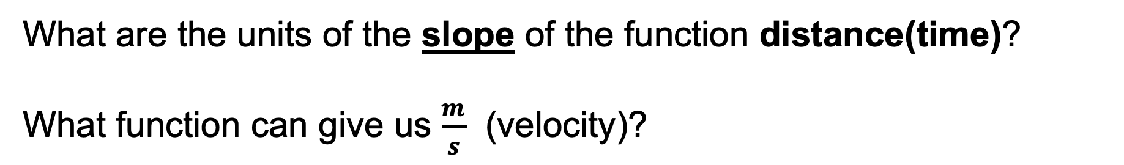


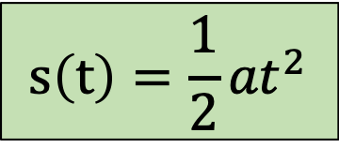
$$distance [m]$$
$$8$$
$$7$$
$$6$$
$$5$$
$$4$$
$$3$$
$$m$$
$$s\left(t\right)=\frac{1}{2}{at}^{2}$$
$$2$$
$$1$$
$$s$$
$$0$$
$$0$$
$$1$$
$$2$$
$$3$$
$$4$$
$$time [s]$$
What are the units of the slope of the function distance(time)?
What function can give us $\frac{m}{s}$ (velocity)?

Slide 34






$$v$$
$$\frac{m}{s}$$
$$v\left(t\right)=at$$
$$s$$
$$t$$
What are the units of the slope of the function velocity(time)?
What function can give us $\frac{m}{s^{2}}$ (acceleration)?

Slide 35




An Area involves multiplying by time.
$$a=\frac{F}{M}$$
A Slope involves dividing by time.
$$acceleration$$
area
slope
Calculus
$$velocity$$
area
slope
$$distance$$

Slide 36







An Integral involves multiplying by time.
$$a=\frac{F}{M}$$
A Derivative involves dividing by time.
$$a$$
$$\int{a dt}=at+v_{0}$$
$$\frac{d}{dt}\left(at+v_{0}\right)=a$$
$$at+v_{0}$$
$$\int{\left(at+v_{0}\right) dt=\frac{1}{2}at^{2}+v_{0}t+s_{0}}$$
$$\frac{d}{dt}\left(\frac{1}{2}at^{2}+v_{0}t+s_{0}\right)=at+v_{0}$$
$$\frac{1}{2}at^{2}+v_{0}t+s_{0}$$

Slide 37











When a sample rate is used (example: computer programming), then slope and area become:
$$v_{1}$$
$$v\left(t\right)$$
$$\frac{m}{s}$$
$$v_{0}$$
$$\frac{m}{s^{2}}$$
$$m$$
$$0$$
$$t_{0}$$
$$t_{1}$$
slope:
area:
$$a\left(t_{1}\right)=\frac{\left(v_{1}−v_{0}\right)}{\left(t_{1}−t_{0}\right)}$$
$$s\left(t_{1}\right)=\left[\frac{v_{1}−v_{0}}{2}+v_{0}\right]\left(t_{1}−t_{0}\right)+s_{0}$$

Slide 38









When a sample rate is used (example: computer programming), then slope and area become:
Even if acceleration is not a constant, then this form still works!
$$a_{1}$$
$$a\left(t\right)$$
$$\frac{m}{s^{2}}$$
$$a_{0}$$
$$\frac{m}{s^{3}}$$
$$\frac{m}{s}$$
$$0$$
$$t_{0}$$
$$t_{1}$$
slope (jerk):
area (velocity):
$$j\left(t_{1}\right)=\frac{\left(a_{1}−a_{0}\right)}{\left(t_{1}−t_{0}\right)}$$
$$v\left(t_{1}\right)=\left[\frac{a_{1}−a_{0}}{2}+a_{0}\right]\left(t_{1}−t_{0}\right)+v_{0}$$

Slide 39





When a sample rate is used (example: computer programming), then slope and area become:
…And if acceleration is a constant, then it still works:
$$\frac{m}{s^{2}}$$
$$a_{0}$$
$$a\left(t\right)$$
$$\frac{m}{s}$$
$$0$$
$$t_{0}$$
$$t_{1}$$
slope (jerk):
area (velocity):
$$j\left(t_{1}\right)=\frac{\left(0\right)}{\left(t_{1}−t_{0}\right)}=0$$
$$v\left(t_{1}\right)=\left[\frac{0}{2}+a_{0}\right]\left(t_{1}−t_{0}\right)+v_{0}=a_{0}\left(t_{1}−t_{0}\right)+v_{0}$$

Slide 40


General form of numerical slope and area:
$$slope\left(t_{n}\right)=\frac{f(t_{n})−f(t_{n−1})}{t_{n}−t_{n−1}}$$
$$area\left(t_{n}\right)=\left[\frac{f(t_{n})−f(t_{n−1})}{2}+f(t_{n−1})\right]\left(t_{n}−t_{n−1}\right)+area(t_{n−1})$$
$$area\left(t_{n}\right)=\frac{1}{2}\left[f\left(t_{n}\right)+f(t_{n−1})\right]\left(t_{n}−t_{n−1}\right)+area(t_{n−1})$$

